Slide 1
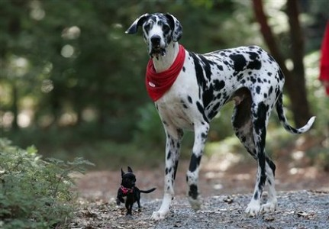
BODY SIZE : Processes

Slide 2
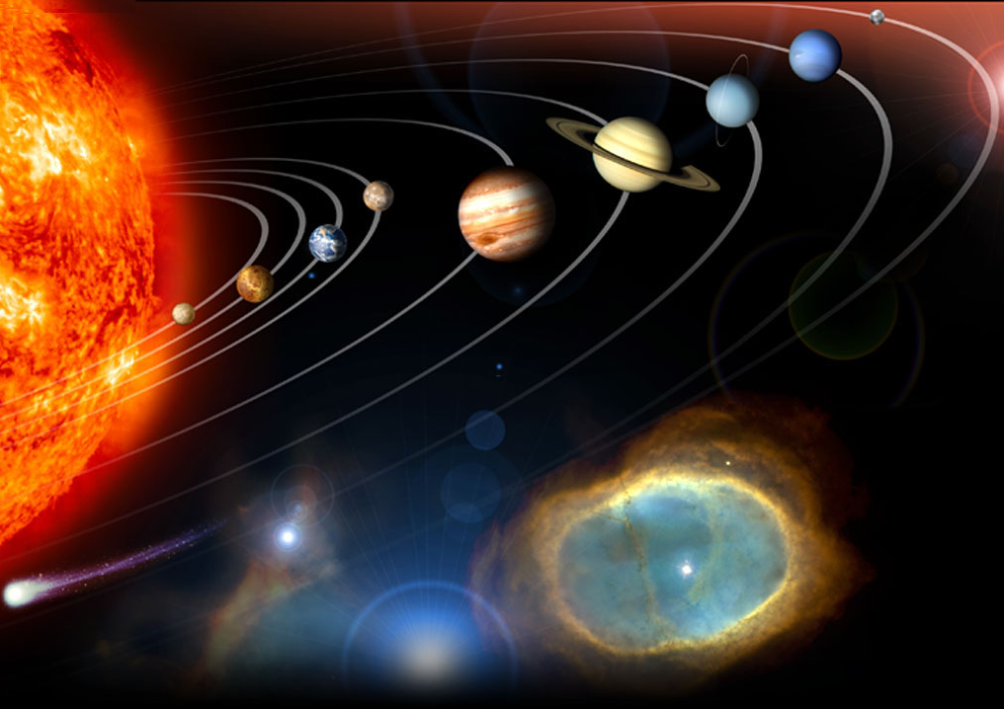
Life, as we know it, occurs within a very narrow set of conditions
2. A terrestrial planet
1. Source of constant and stable energy
3. The right distance from the energy source
To cool
To hot
4. Need a satellite star
5. Near circular orbit
6. The right place in the galaxy
7. Carbon and oxygen
8. Magnetic shield
Notes:
Requirements for life
a solar system with a single massive Sun than can serve as a long-lived, stable source of energy
a terrestrial planet (non-gaseous)
the planet must be the right distance from the sun in order to preserve liquid water at the surface – if it’s too close, the water is burnt off in a runaway greenhouse effect, if it’s too far, the water is permanently frozen in a runaway glaciation
the solar system must be placed at the right place in the galaxy – not too near dangerous radiation, or to be absorb by their gravity
a moon of sufficient mass to stabilize the tilt of the planet’s rotation
A near circular orbit to maintain water in its surface
an oxygen-rich atmosphere
a sweeper planet to deflect comets, etc.
planetary neighbors must have non-eccentric orbits to avoid collitions
Carbon for encoding biological information to allow it to replicate itself. The only element in the periodic table that allows you to encode information is carbon.
Oxigen to fuel metabolisms and independence of organinms
http://winteryknight.wordpress.com/2009/04/02/what-conditions-are-needed-to-create-a-habitable-planet/
http://www.arn.org/docs/gonzalez/gg_arewealone.htm

Slide 3
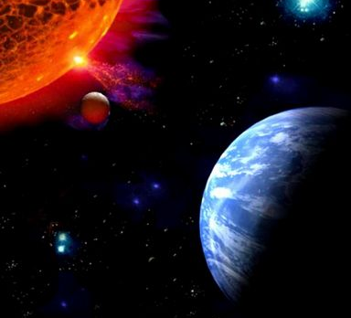
A basic principle:
Energy
BIOMAS
Body size
Number of species
Abundance
Notes:
The absolute amoun of life cannot exceedd that which can be supported by the harnessing of all energy arriving from the sun (Gaston & Blackburn2002). In this frame work two elements abut species become of prime interest: body size and abundance. Offcourse the amount of energy varies depending o body size so that larger animals often use more resources to fuel their metablism. In turn, the abundance of individuals is crtiical is this energetic equation. In a world of finite resources it follows that there should be strong relationship between body size, abudnace and species richness.

Slide 4
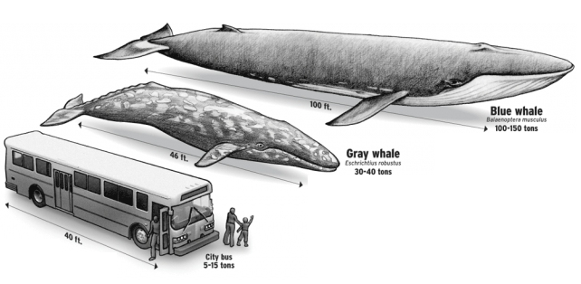
Why a species has the body size it does?
Optimum trade-off
Cost
Ecological /
Evolutionary
forces
Benefit
Body size

Slide 5
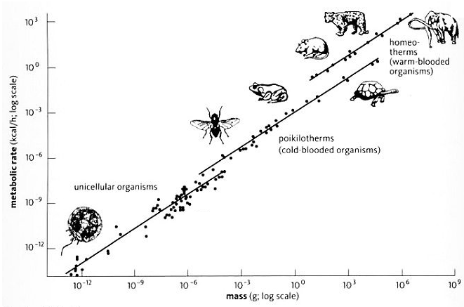
Evolutionary forces: resource availability
Large individuals use ↑ Resources
Small individuals use ↓ Resources
Environment’s role
Resource available ↓
Resulting body size ↘
Resource available ↑
Resulting body size ↗
Notes:
In absolute terms, large species need more resources than small species

Slide 6
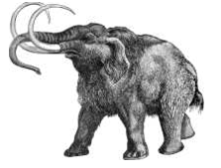
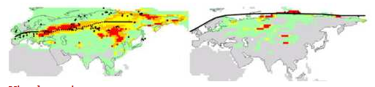
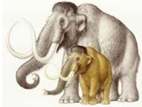
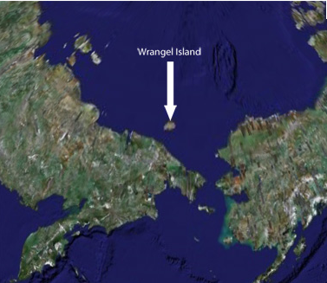
Evolutionary forces: resource availability evidence
41,000 y BP
12,000 y BP
Extinct 9,500 y BP
Individuals 25% smaller were found in a small island
Fossils dated 7,000–4,000 yr BP
No humans
Russia
Alaska
No glaciation
Dwarfing most likely due to limited resources
Vartanyan et al., Nature 1993

Slide 7
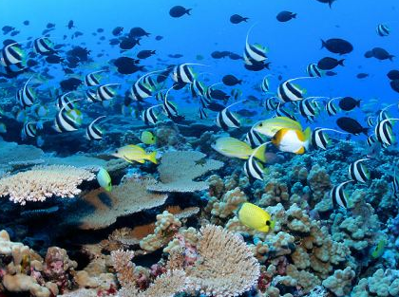
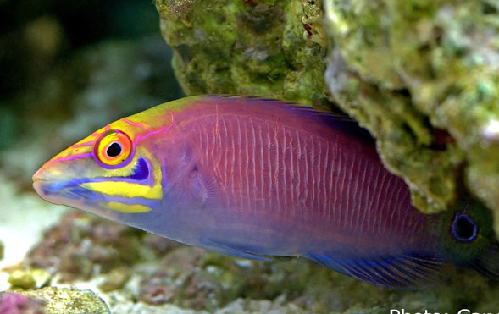
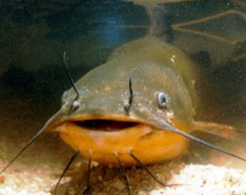
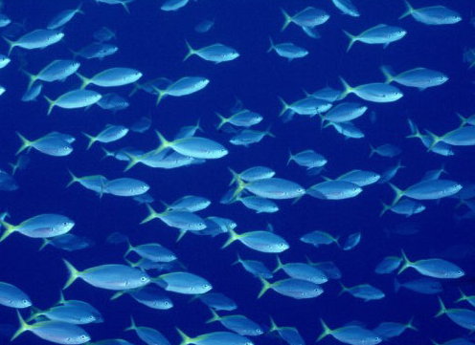
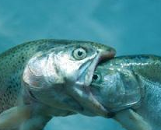
Evolutionary forces: ecological forces
PREDATION
PREY
Expected size
PREDATOR
Smaller is better
Bigger is better

Slide 8
Evolutionary forces: ecological forces
Competition
Time
Time
Distribution of organisms
Resource variation
By specializing, species use a smaller spectrum of available resources… so they have to compromise either their size or their abundance
Notes:
It is not that new resources are made up. It is just that species become better at exploiting a part of the spectrum. Yet that means that they have to compromise either their size or abundance.

Slide 9
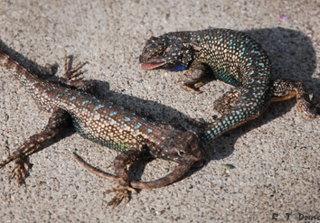
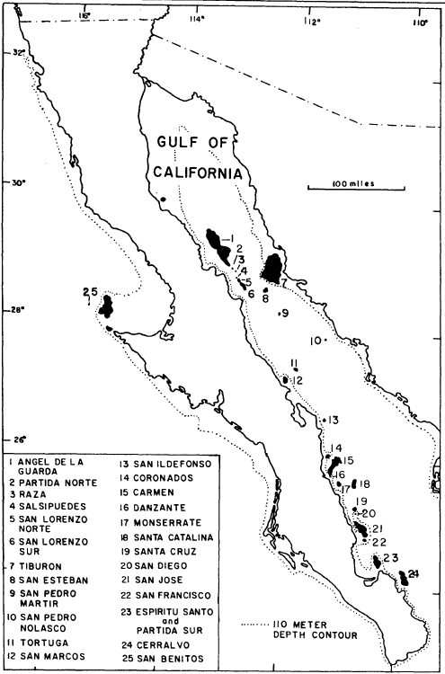
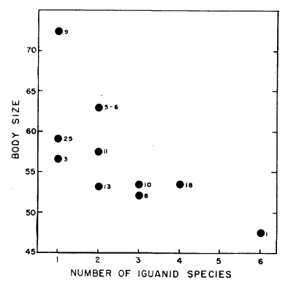
Evolutionary forces: ecological forces
Competition: Soule 1966 classic work
Smaller is better…
…or rather smaller is forced

Slide 10
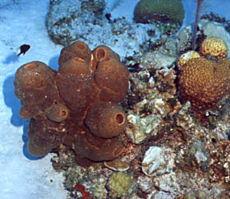
Types of competition: by interference & by exploitation
BY INTERFERENCE: one species prevent other species of accessing a limiting resource.
Example: Territorial damselfishes
competing for benthic algae
How will body size change over time under this type of competition among species?

Slide 11
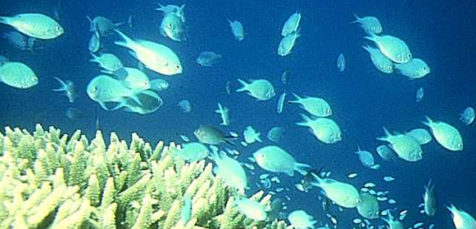
Competition
BY EXPLOITATION: two o more species have free access to a limiting resource
and variation among species in competitive abilities will
determine variations in species performance: eg. growth,
reproduction.
Such sort of competition is common among species that compete
for resources that are not defensible spatially.
Example: Damselfishes of the genus Chromis competing for plankton
How will body size change over time under this type of competition among species?

Slide 12
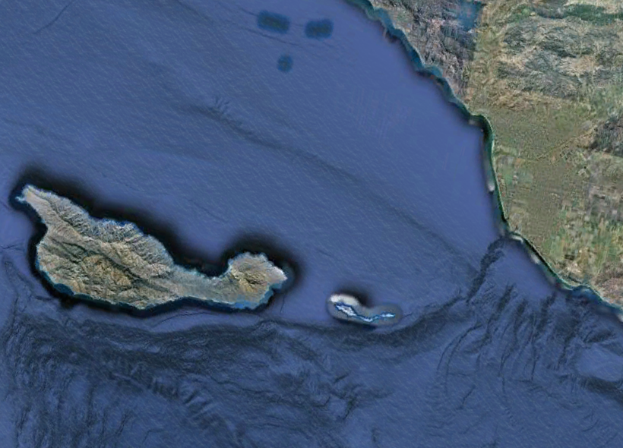
Evolutionary forces: ecological forces
Competition and the Taxon Cycle (E. O. Wilson 1961)
Abundance
Body size
Notes:
An island with only one speccies resident will evlove towards an optimum body size for the island (plots 1 and 2). If the island in then colonized by a larger species, this will evolve towards the optimum size, while competing with the other species who has loss competititve avility, the original resident speccies will shrink in size and abundance. Ultimate the recent colonizer will achive the optimum size while the original colonizer could go extinct. (Page 447 Brwon and lomolino book).

Slide 13
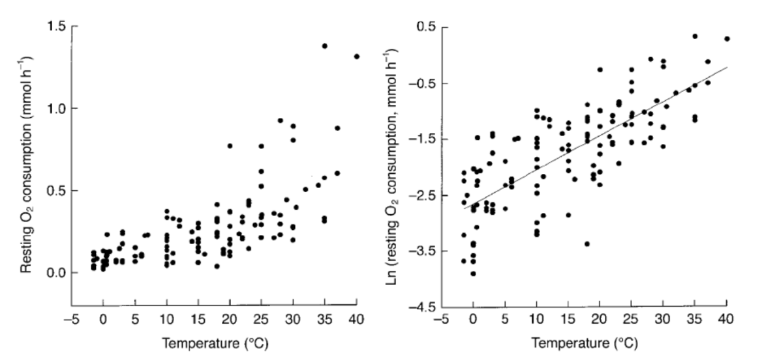
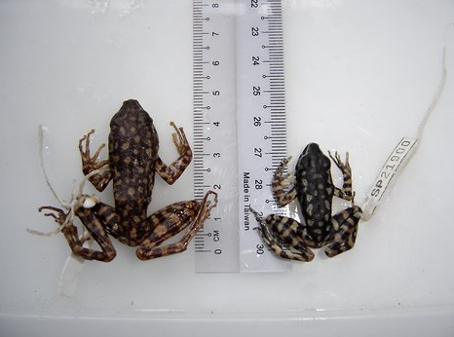
Evolutionary forces: climate
In laboratory experiments, for every 2 degrees the scientists cranked up the temperature, various types of fruit flies decreased anywhere from 3 to 17 percent. For fish, the shrinking was even more pronounced, from 6 to 22 percent
Clarke & Jonhston, J. Ani.Ecol. 1999
Energy required to maintain metabolisms increase with increasing temperature
A male frog specimen from Mount Kinabalu in Malaysia
1980s
2008
Everything else being equal
Body size should reduce with increasing temperature
Sheridan & Bickford, Nature Climate Change 2011

Slide 14
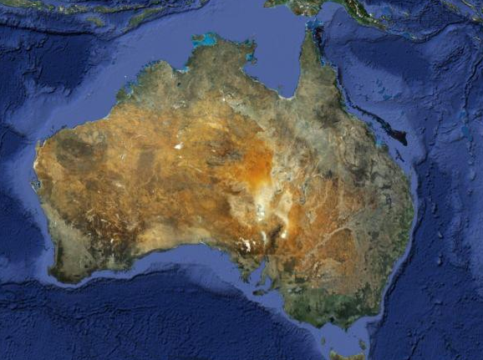
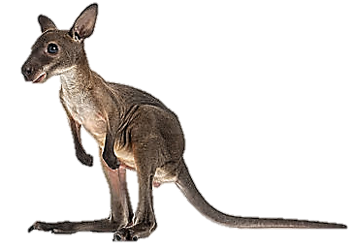
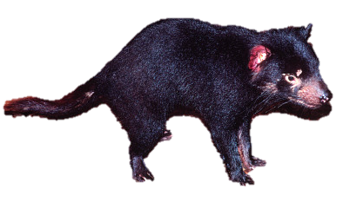
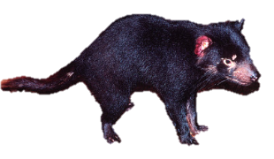
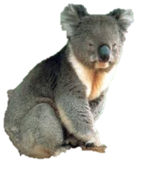
Evolutionary forces: hunting
40,000 years
Wallaroo
Tasmanian devil
Koala
Flannery Book 1994
Nothing explains this reduction in body size better than the fact that humans colonized the islands some 40,000 years ago and that humans liked bigger animals
Selection on the fittest

Slide 15
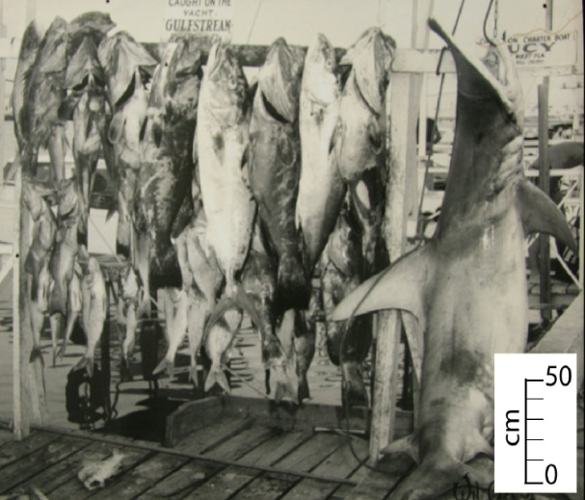
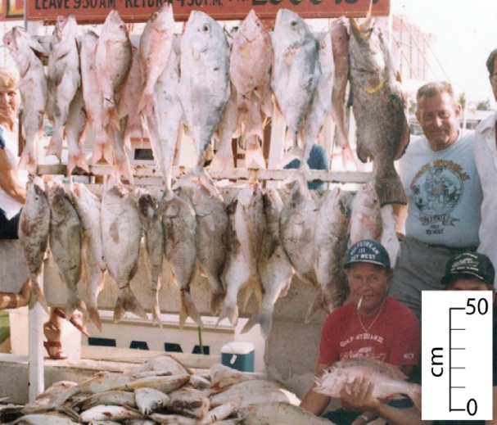
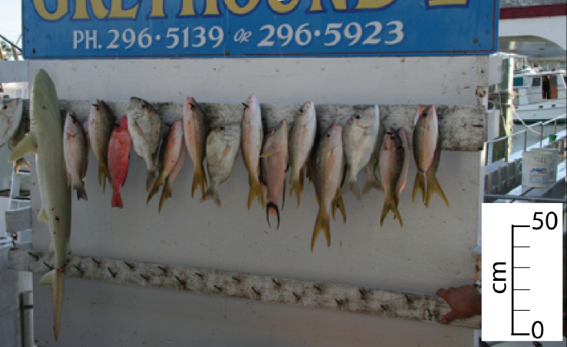
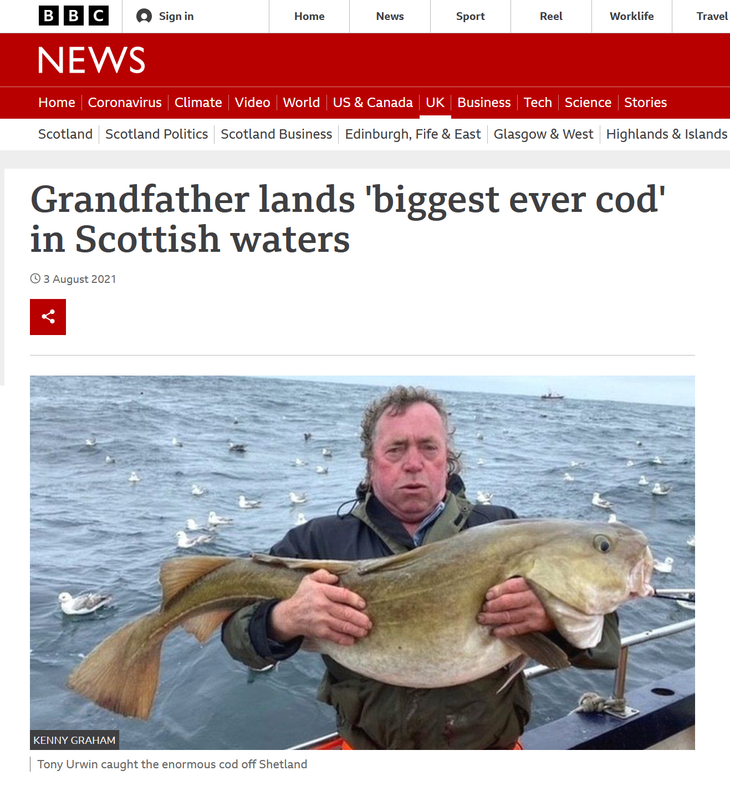
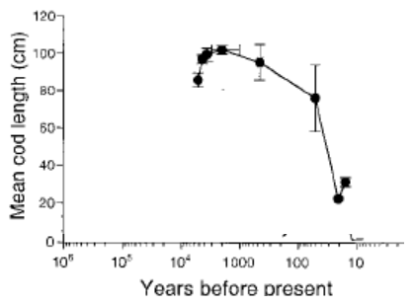
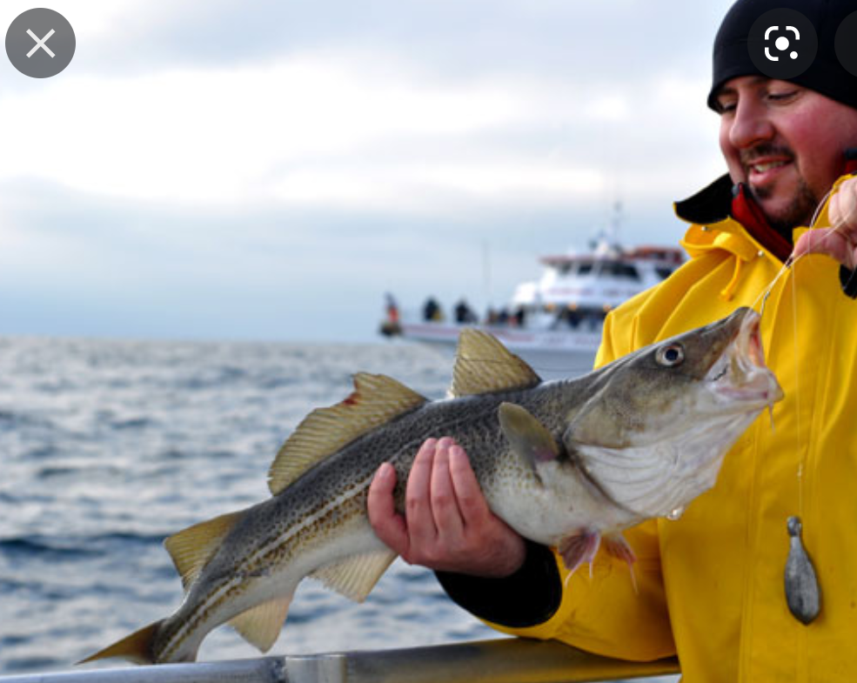
Evolutionary forces: fishing
1957
1980
2007
MacClanaham Conservation Biology 2009
Jackson et al, Science 2001

Slide 16
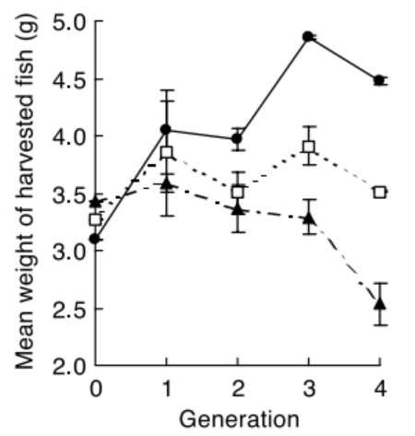
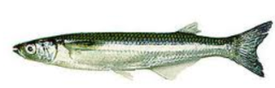
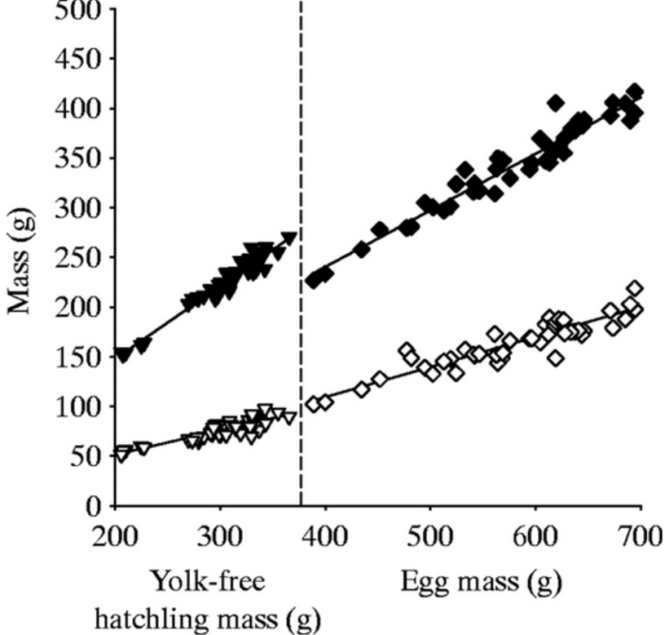
Consequences of overharvesting
EXPERIMENTS
REALITY
Small fish harvested
Random fish harvested
Jackson et al, Science 2001
Atlantic silverside
Large fish harvested
Conover et al., Science 2002
Dzialowski & Sotherland
J. Exp. Biol. 2006
smaller survival = smaller larval size
<
Overpopulation = input < output
EXTINCTION VORTEX

Slide 17
In summary
Resources
Interactions: predation, competition
Determinants
Climate
Human driven evolution
Body size

